Slide 1
Weekly Project Update
Laurent Bialylew
Daniil Karbukov
Xie Wenhao

Slide 2
Work done last week
01
02
03
Updated UMLs
Record prescription
Update and retrieve medical history

Slide 3
Work done this week
01
02
03
Created and updated UMLs
Added function for billing
Expanded existing UMLs with new functions
Function to add bills to patient data
Insurance checking
Checks if patient has insurance

Slide 4
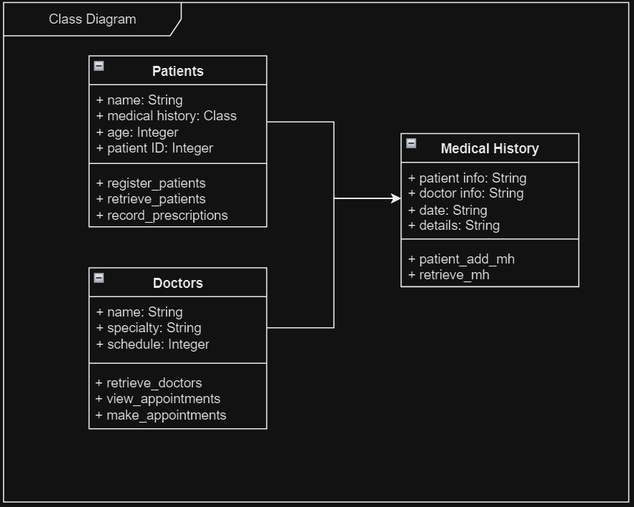
Class UML

Slide 5
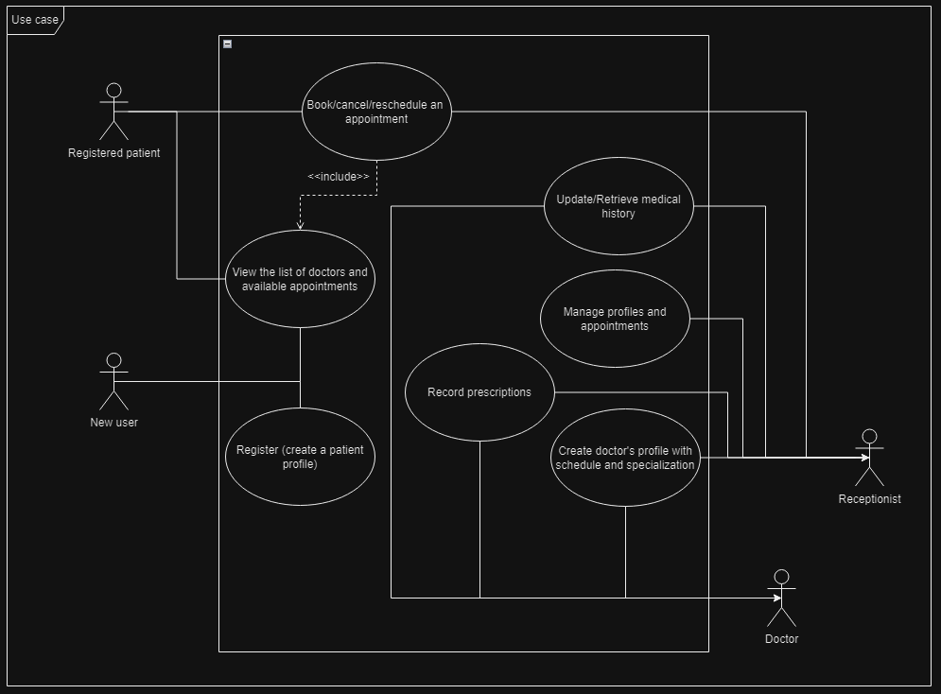
Use case UML

Slide 6
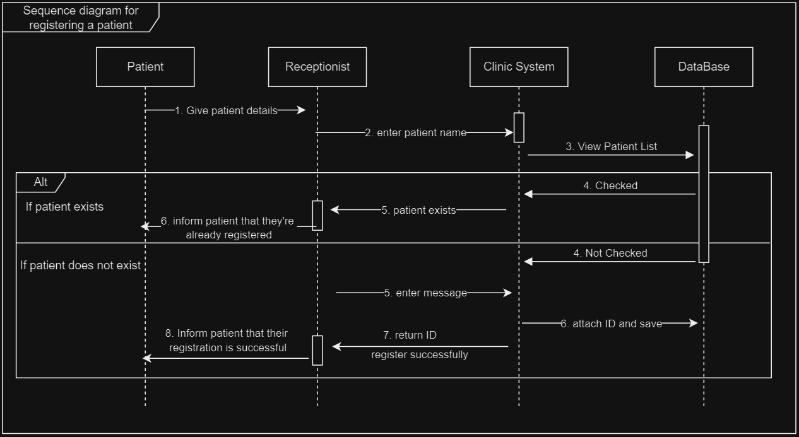
Sequence UML for registering a patient

Slide 7
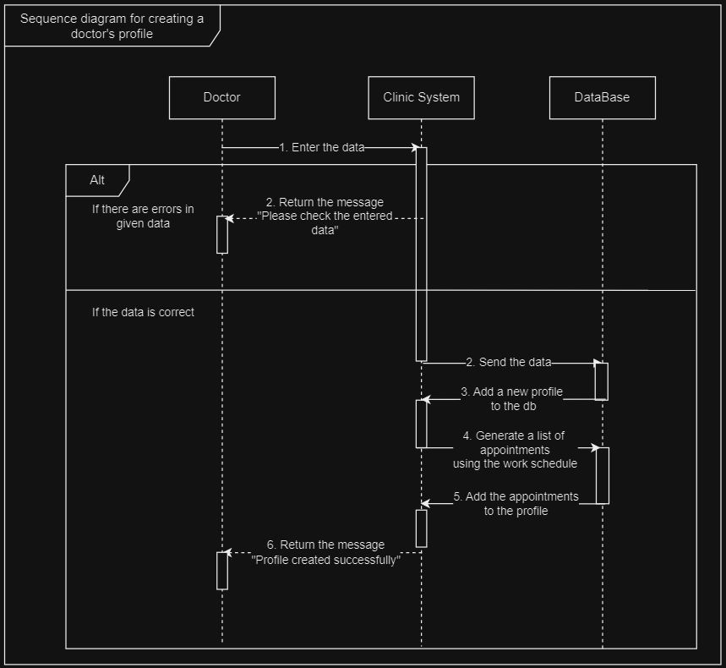
Sequence UML for creating a doctor's profile

Slide 8
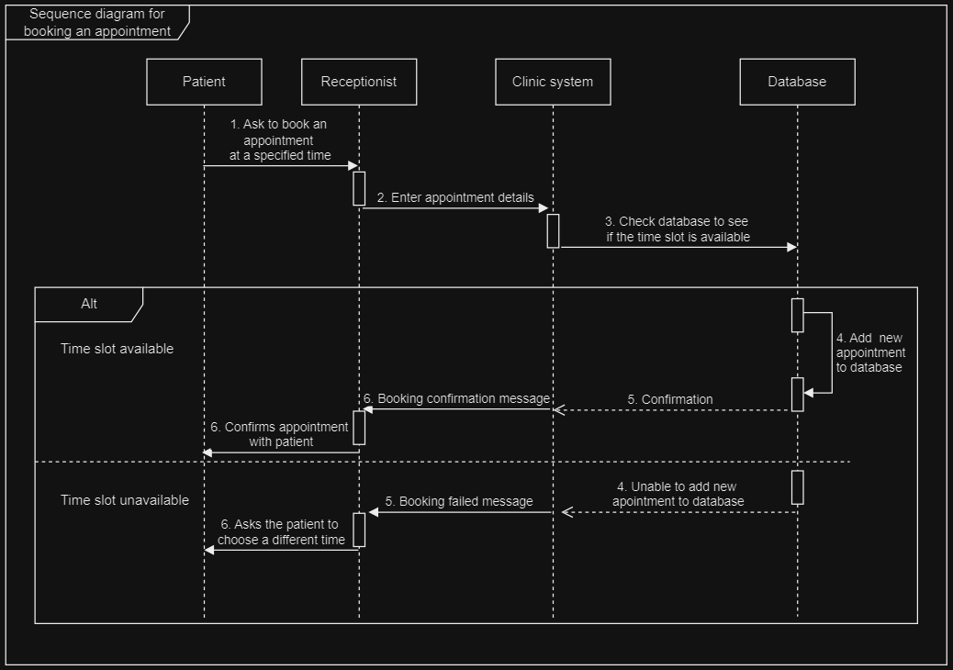
Sequence UML for booking an appointment

Slide 9
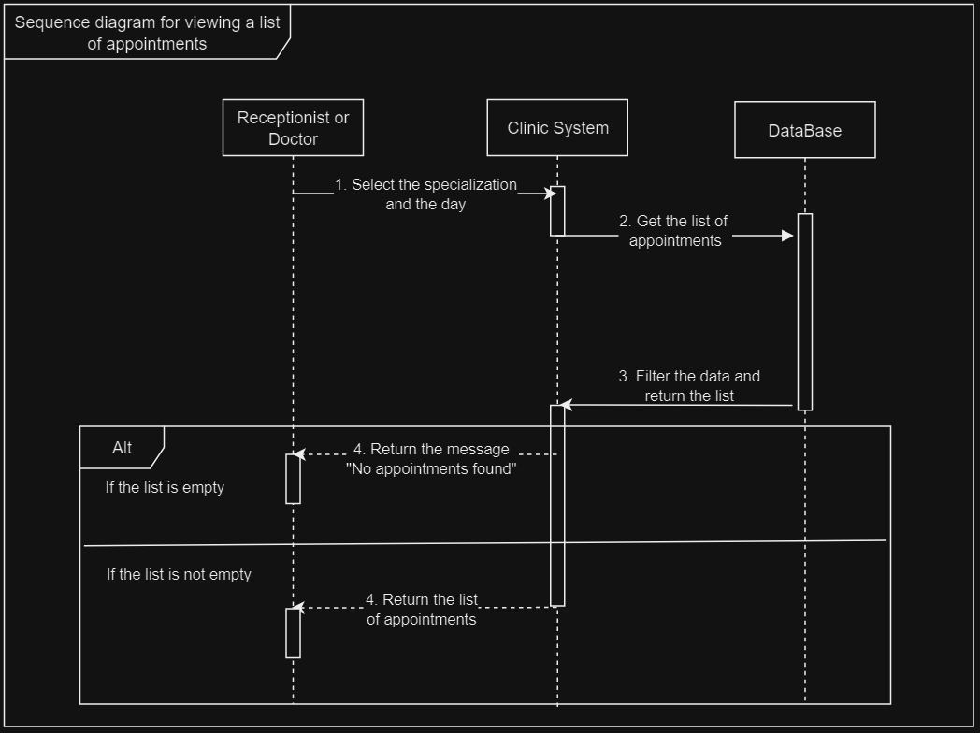
Sequence UML for viewing appointment list

Slide 10
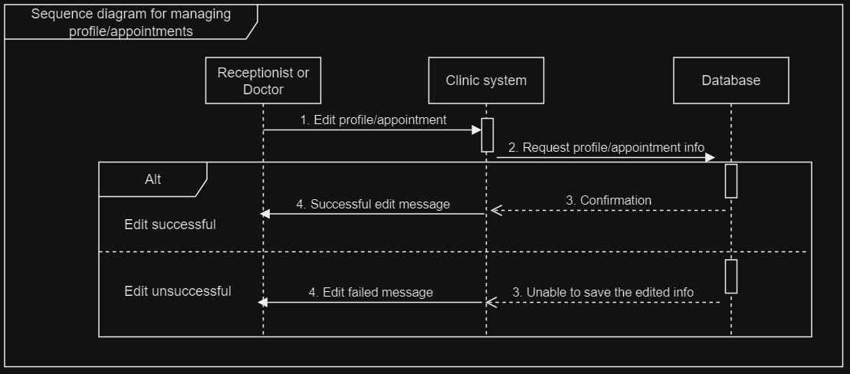
Sequence UML for managing appointments and profiles

Slide 11
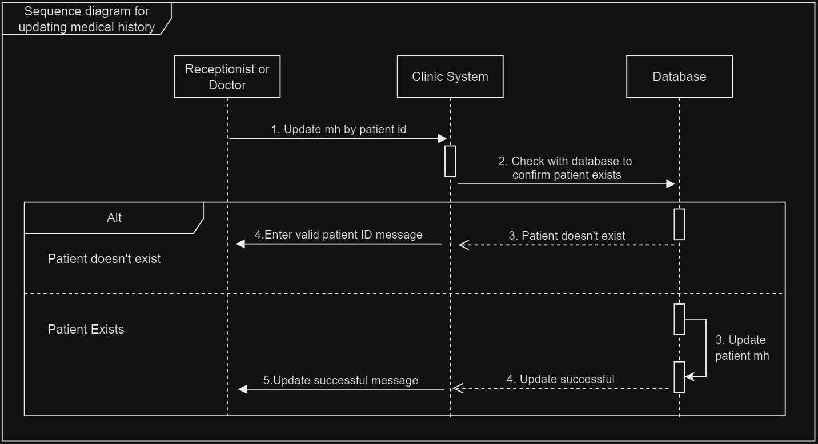
Sequence UML for updating medical history

Slide 12
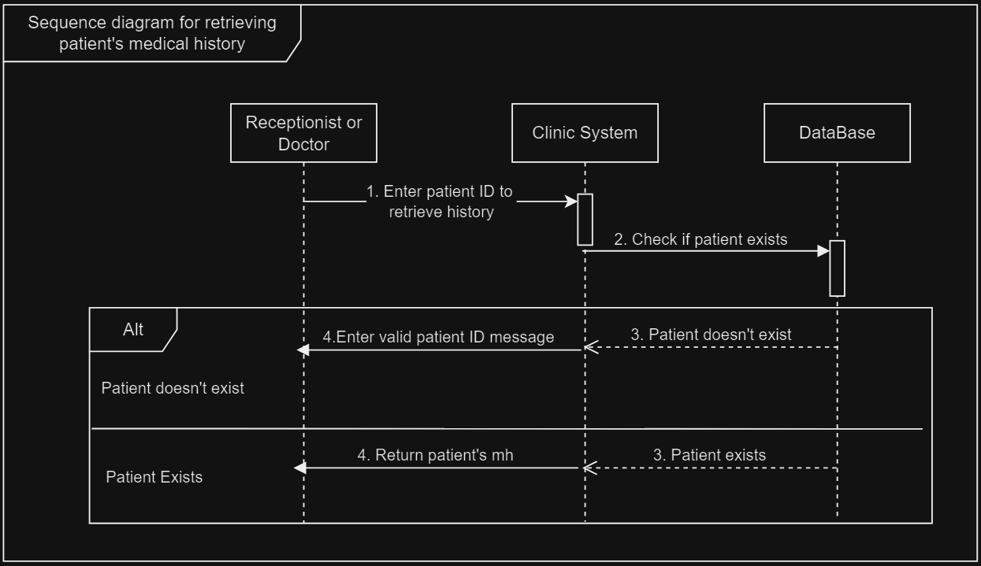
Sequence UML for retrieving medical history

Slide 13
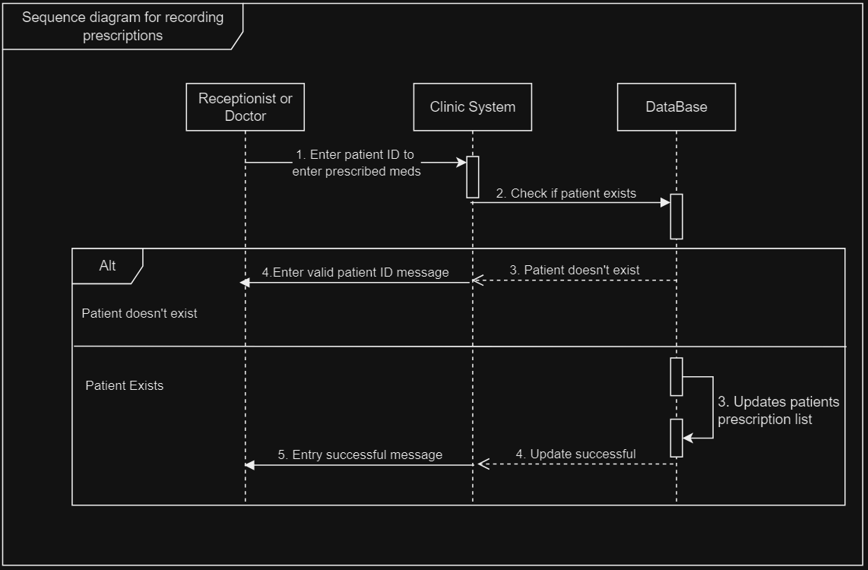
Sequence UML for recording prescriptions

